Slide 1

Bypass management has never been so easy Results Pilot from 19 june until 4 july 2017
INTATION EXTENDS AUTOMATION INTO SUPERIOR BUSINESS PERFORMANCE

Slide 2
Results
15 dagen = 59 unieke interlocks geactiveerd
820 bypass events
+/- 108 manuele (=7,2 bypasses per dag)
+/- 712 geautomatiseerde (48 bypasses per dag)
Niet toegestaan volgens guidelines

Slide 3
Bypass activation per module (All)

Slide 4
Bypass activation per module (ex Auto)

Slide 5
Timeline bypass activation (ex auto)

Slide 6
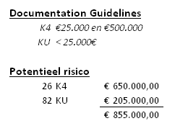
Tijdlijn activatie interlocks (ex auto)

Slide 7

Live Demostration Software

